Slide 1
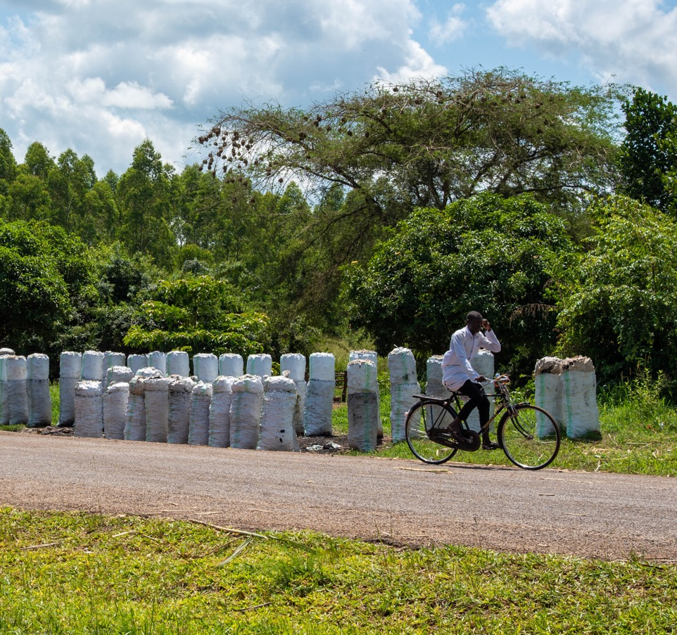



F-me, F-you, fNRB part deux! The latest news from team-MoFuSS Adrian Ghilardi - UNAM Rob Bailis - SEI
Timothy Akolamazima: CC-BY-SA-4.0
ETHOSCon Jan 24-25, 2025

Slide 2
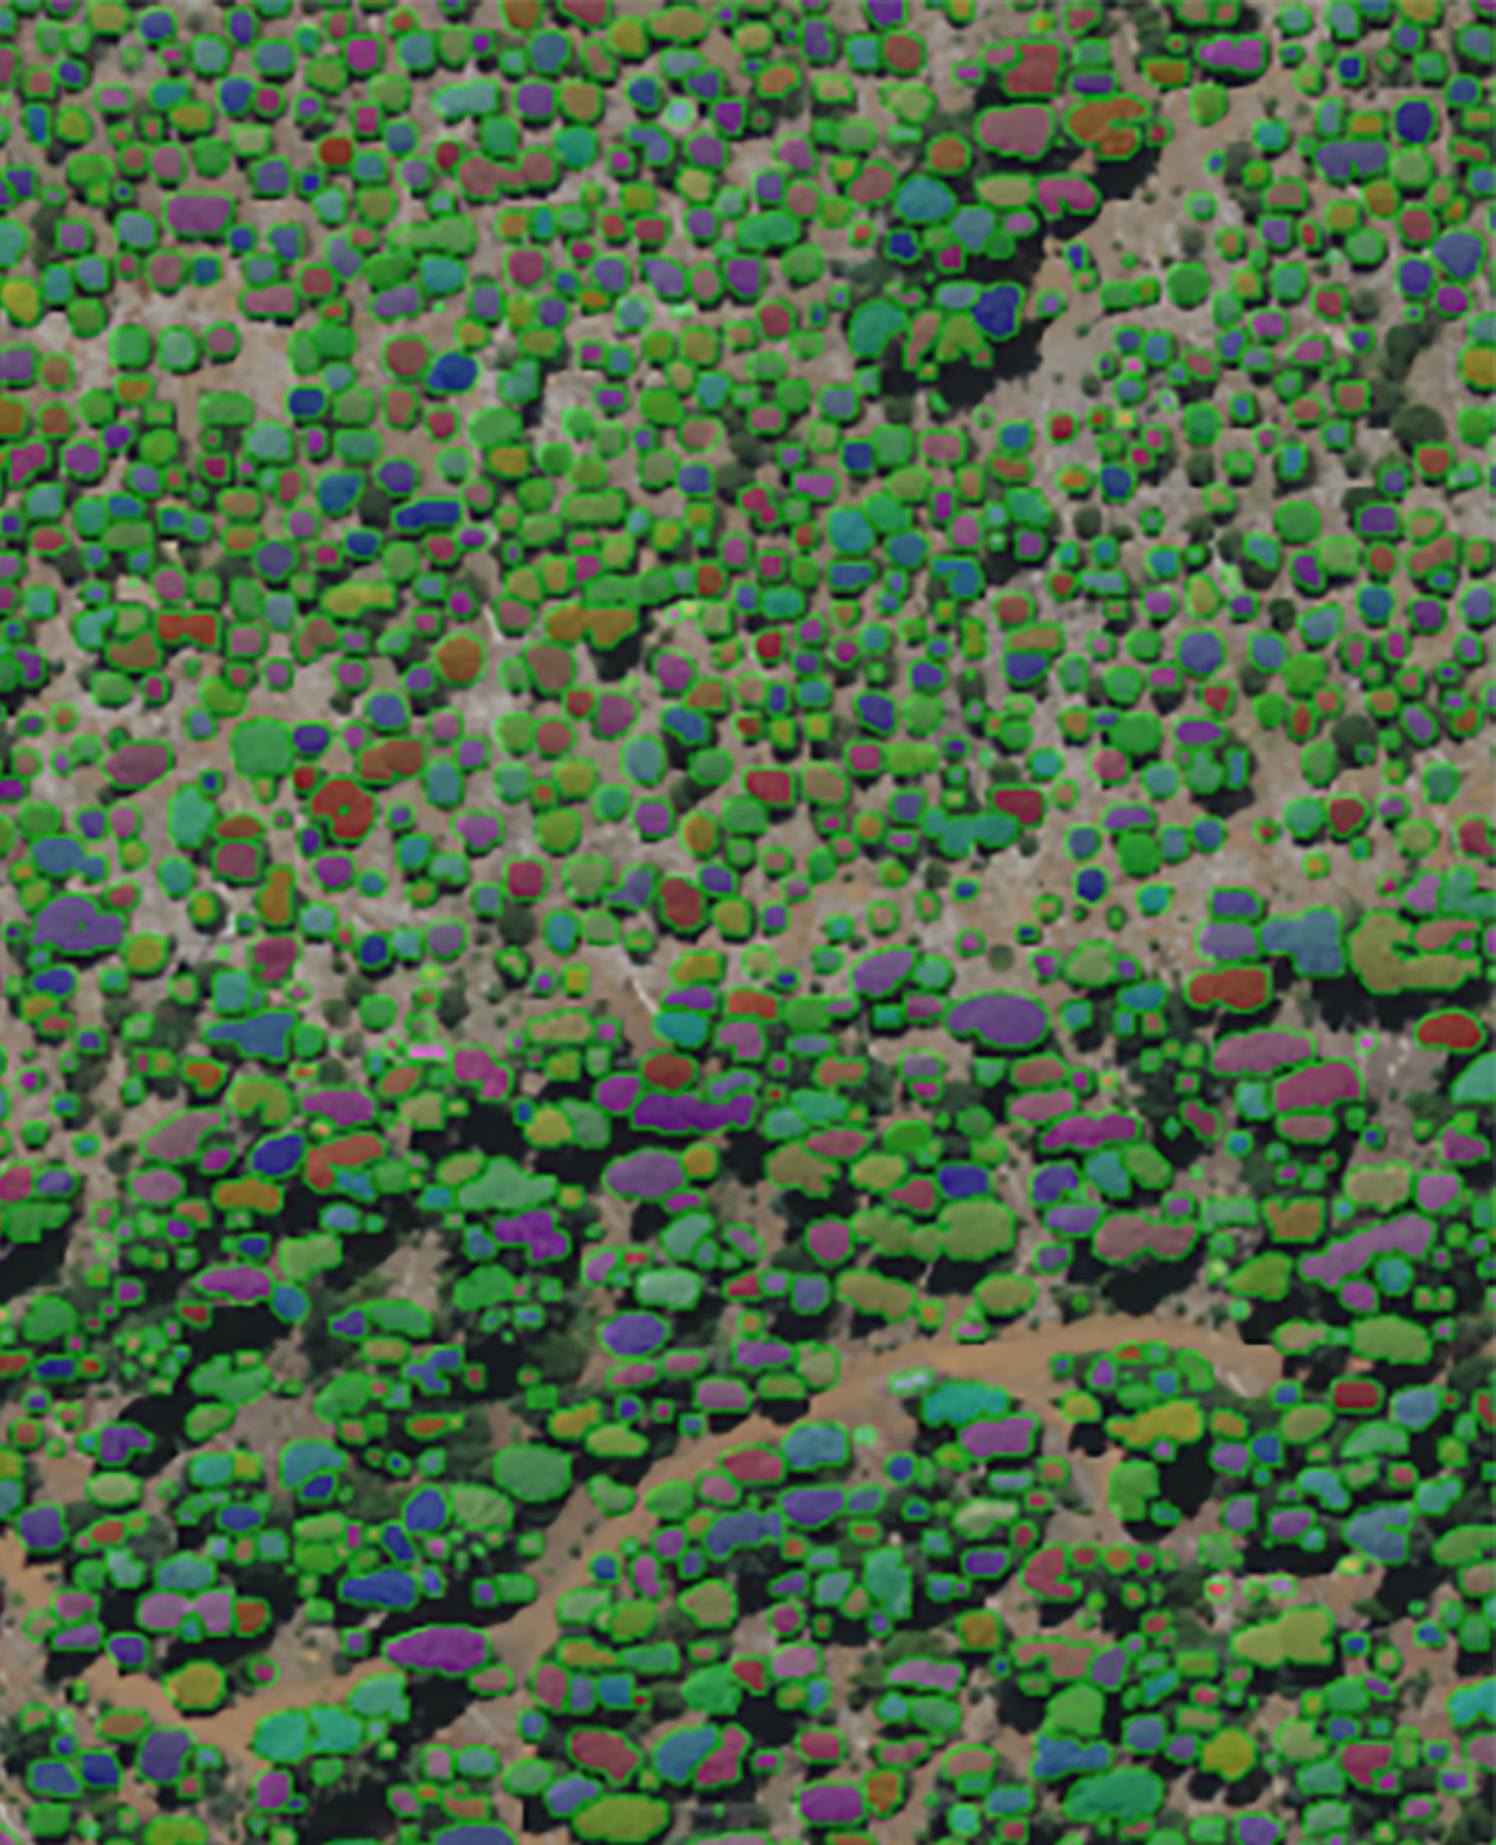
Overview
WebMoFuSS developments and timeline
Validation
Uncertainties
Marginal fNRB
Next steps for the team
https://ctrees.org/products/tree-level

Slide 3
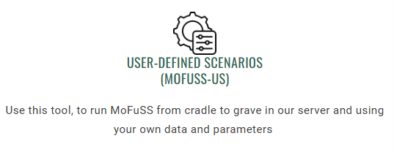
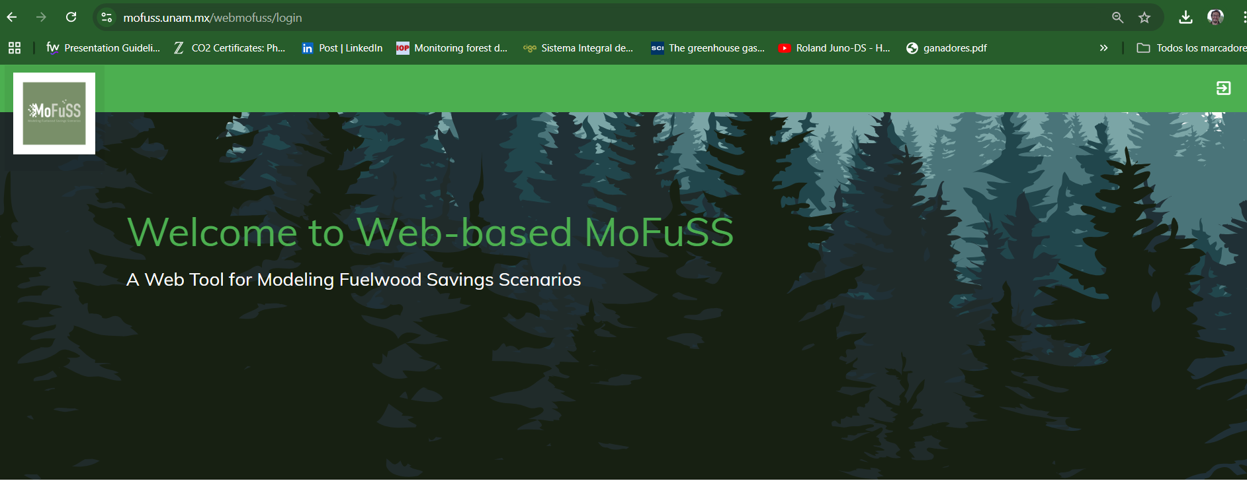
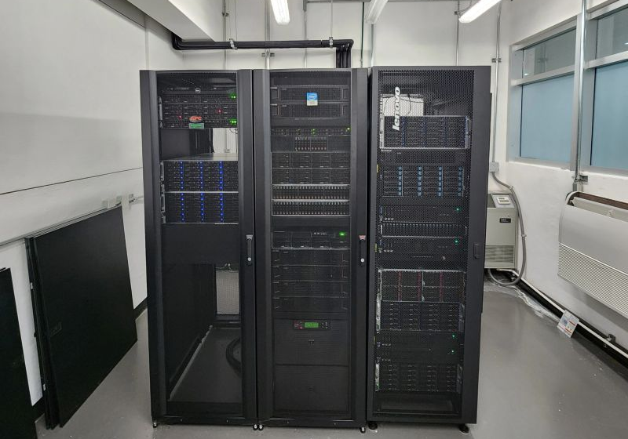

WebMoFuSS developments and timeline
Unique approach: complex modeling BUT user friendly
www.mofuss.unam.mx

Slide 4

WebMoFuSS developments and timeline
1
January 2025 – C++ implementation ✓
2
February 2025 – Area selection and interface
3
April - May 2025 – Linux Core Scripts
4
June 2025 – 1st prototype for 10 concurrent users

Slide 5
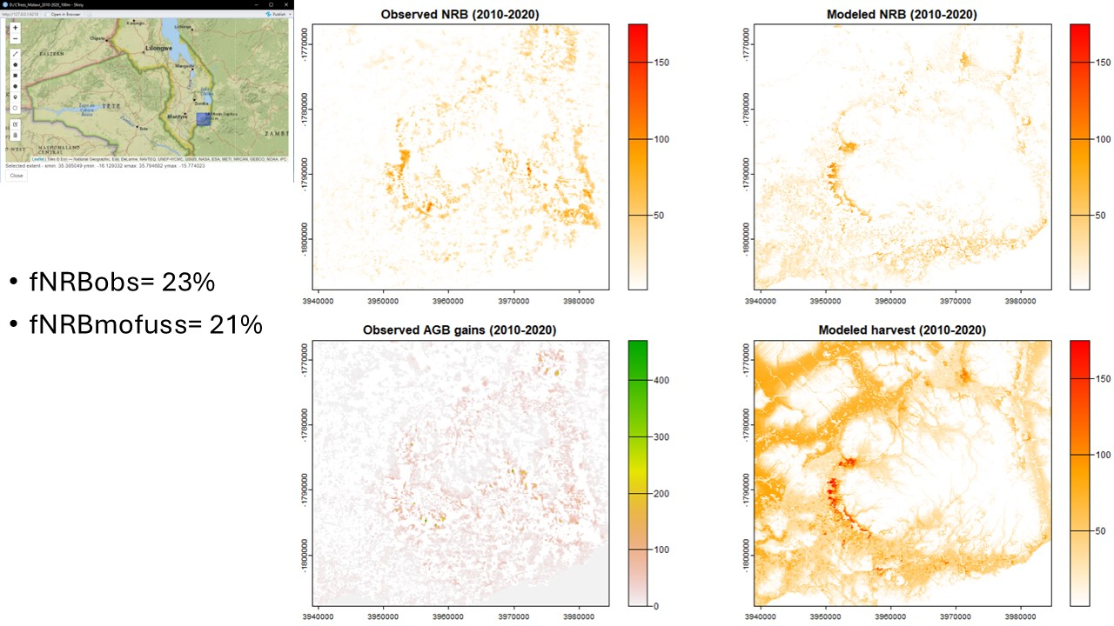
Validation
20km
Full validation is challenging:
Attribution
The future is yet to come
Prediction is very difficult, especially about the future - Niels Bohr

Slide 6
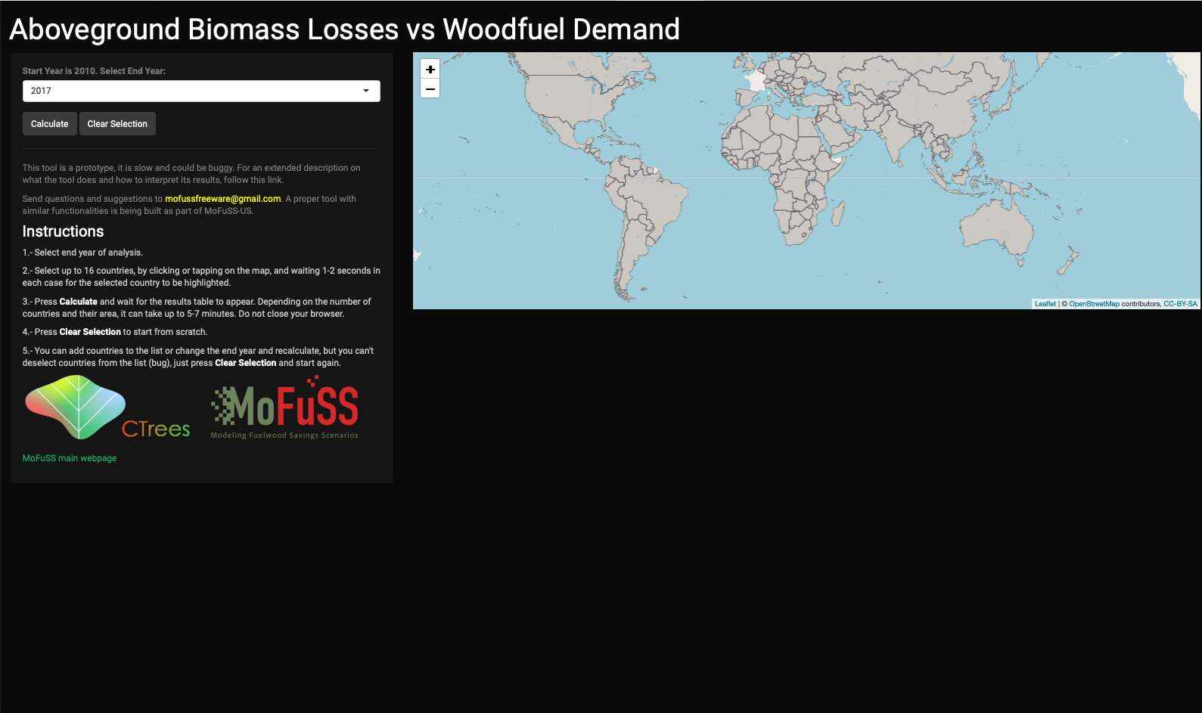
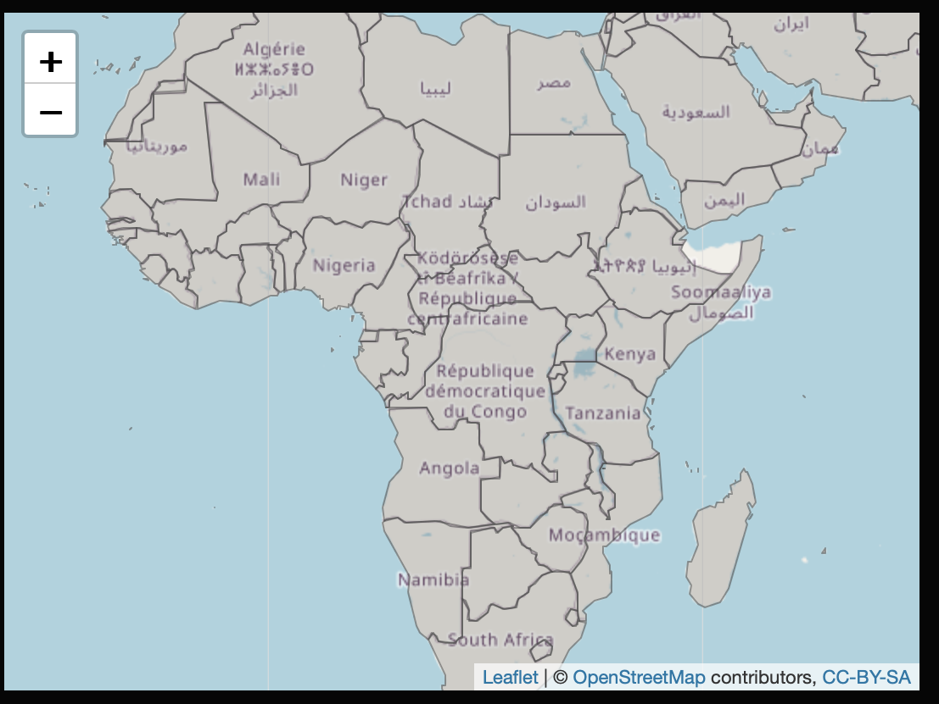
Validation – observed tree cover change helps us to “cap” fRNB
Uses AGB data from CTREES to calculate ∆’s at 1km res*
2010-2017, 2020, & 2022
Divide ∆AGB by estimates of total woodfuel consumption in the same period to estimate an upper bound of fNRB
This assumes all observed tree loss is caused by woodfuel consumption
…its not
https://www.mofuss.unam.mx/fNRB_obs/
* Using 1 km resolution probably underestimates tree loss; higher resolution will very likely result in higher “upper bounds”

Slide 7
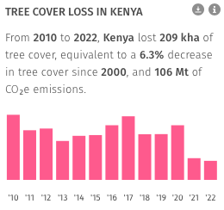
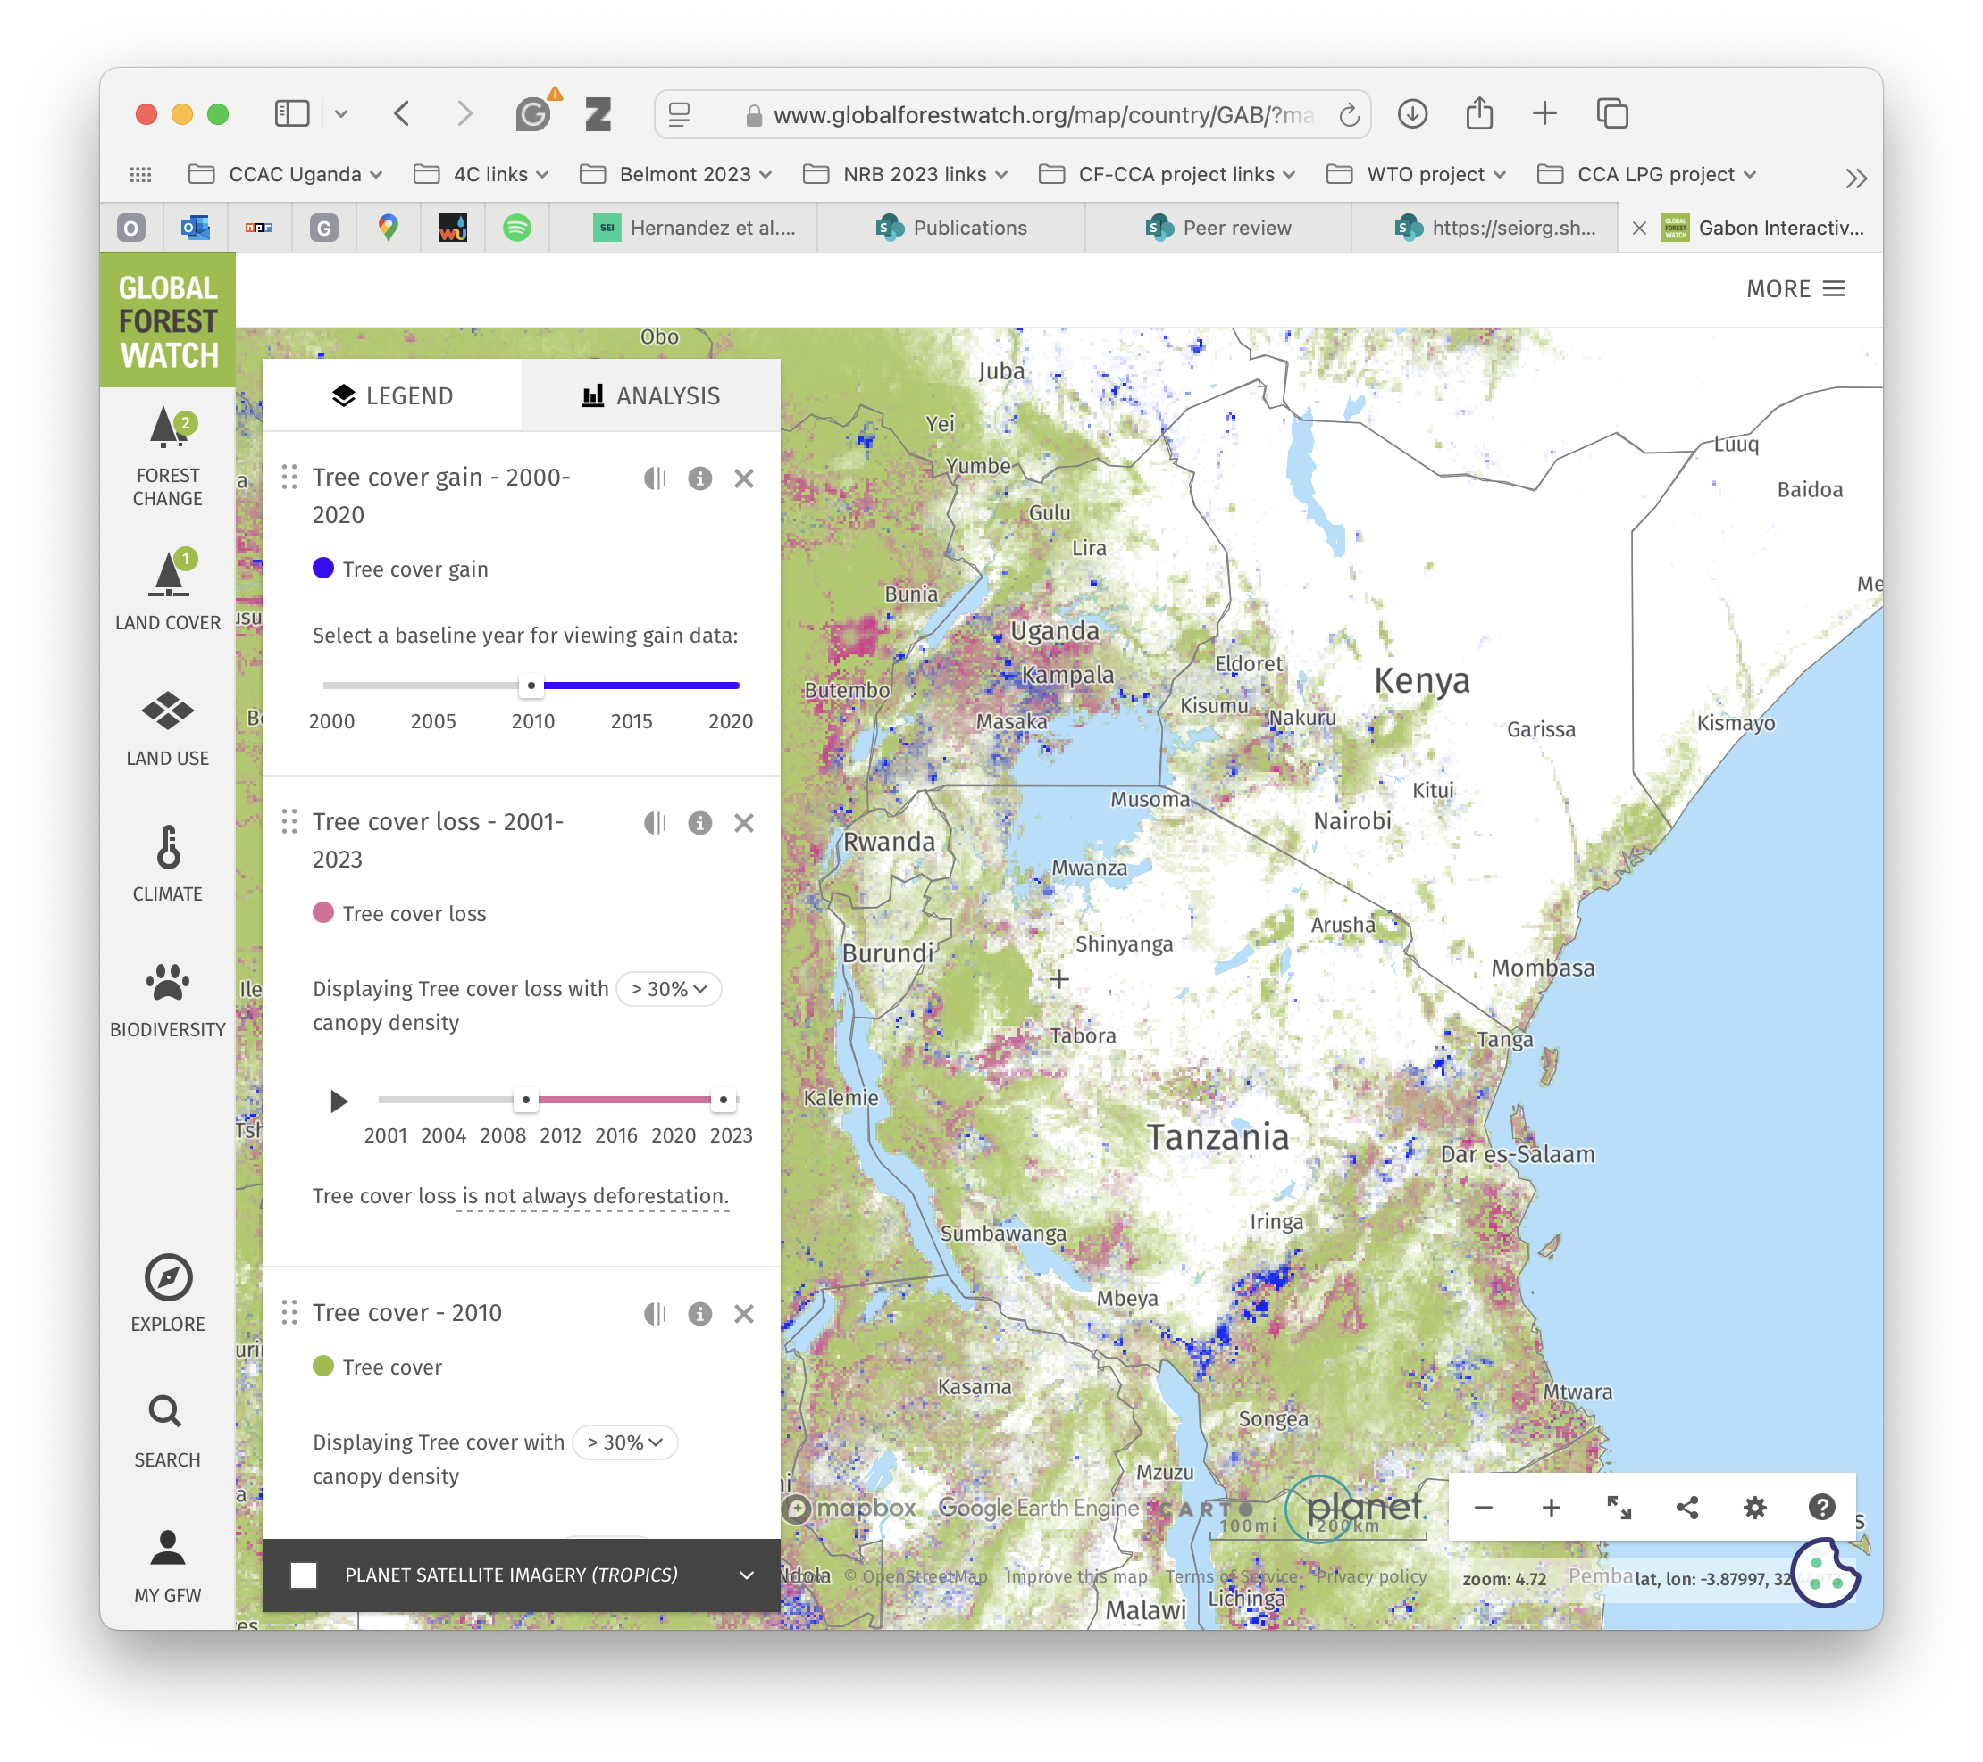
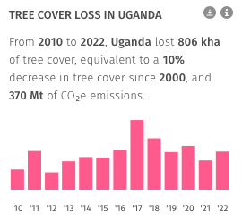
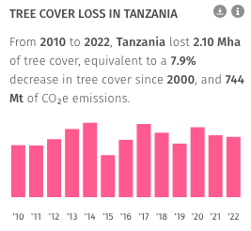
Example from East Africa
https://www.globalforestwatch.org/map
Things to notice
Inter-annual variability
Lack of a well-defined trend
There are also gains
blue areas on the map

Slide 8
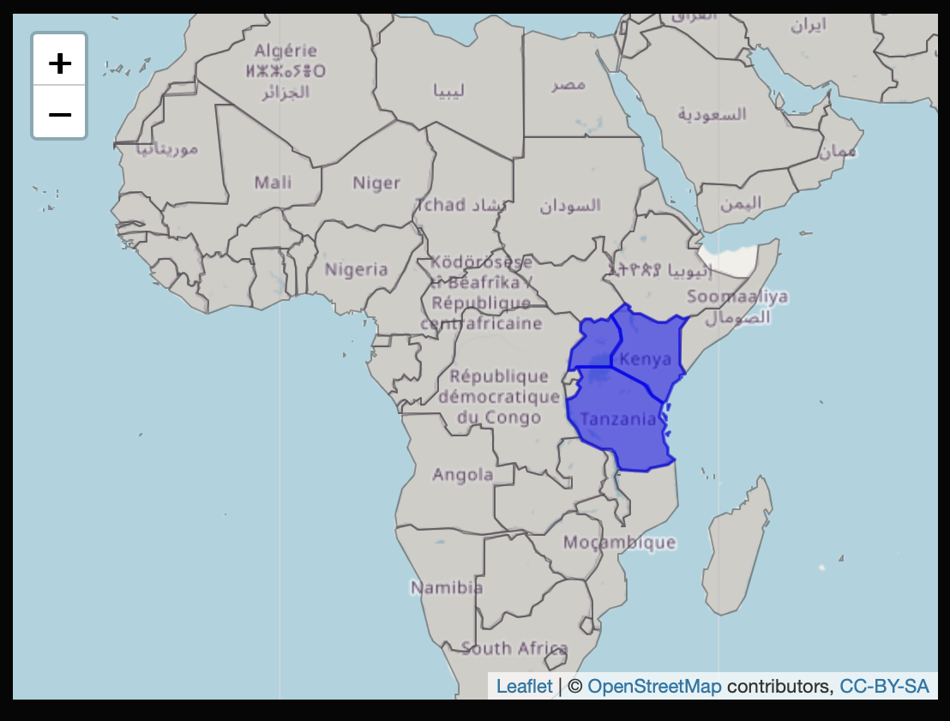
Example from East Africa

Slide 9
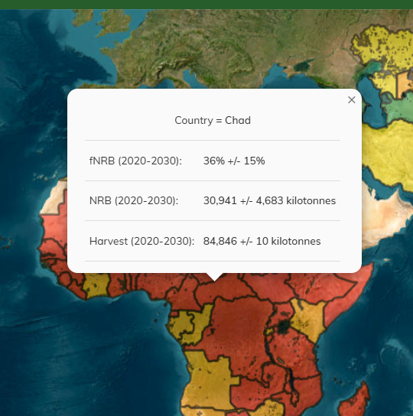
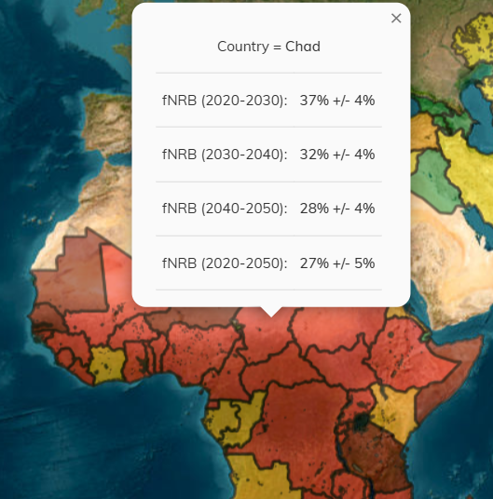
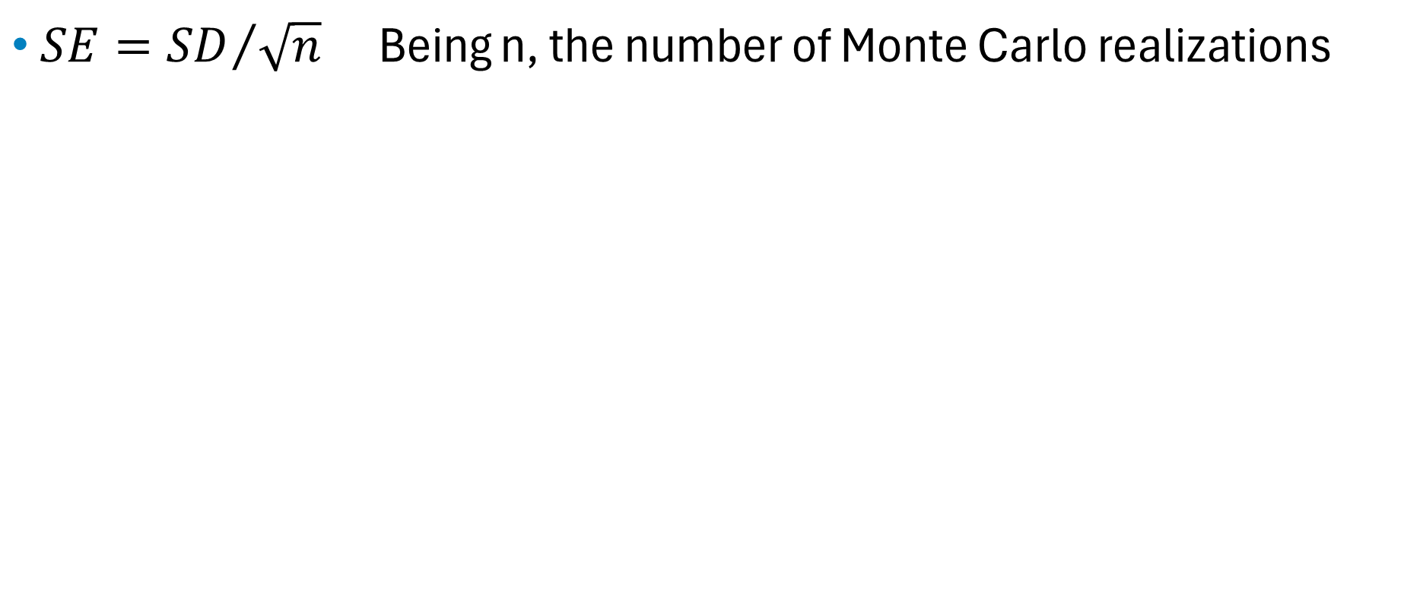
Uncertainties
${SE=SD}/{\sqrt{n}}$ Being n, the number of Monte Carlo realizations

Slide 10
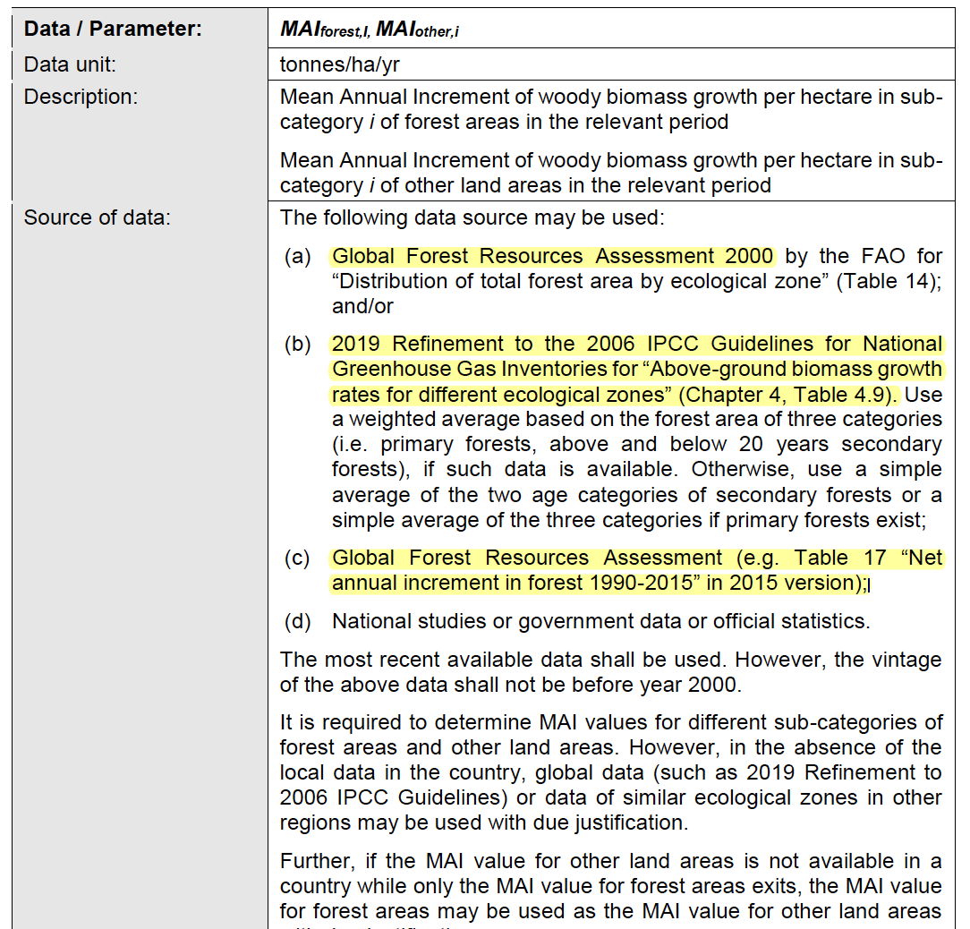
Uncertainty in Tool30
TOOL30 Version 04.0 Data / Parameter table 5 (from Sept, 2022)
Recommended sources of data for forest growth (using mean annual increment – MAI)
To use Tool30, you need to know:
Areas of different types forest
Ideally areas of “trees outside forests” too
Woody biomass growth rates in each forest type
Suggest 3 possible sources as well as “National studies or government data or official statistics”
Woodfuel demand (not covering today)

Slide 11
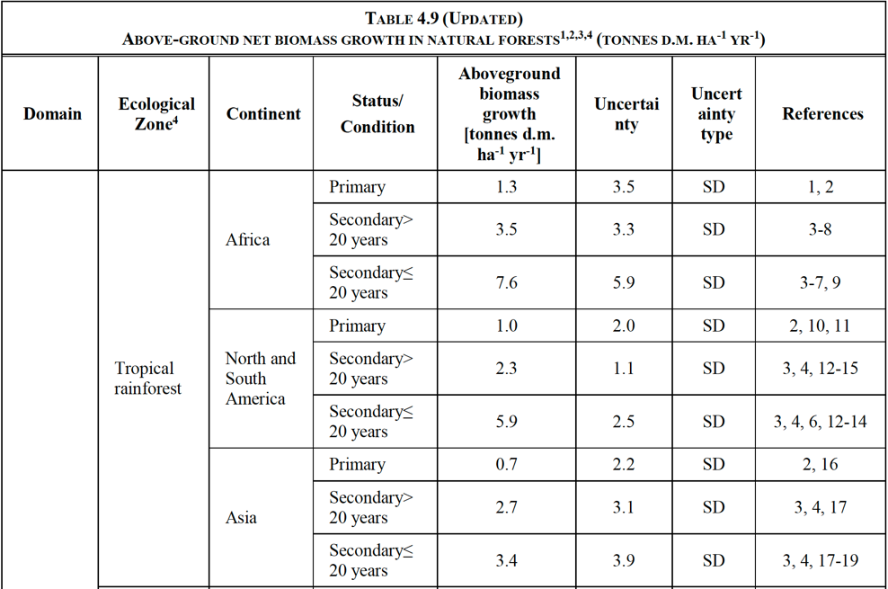
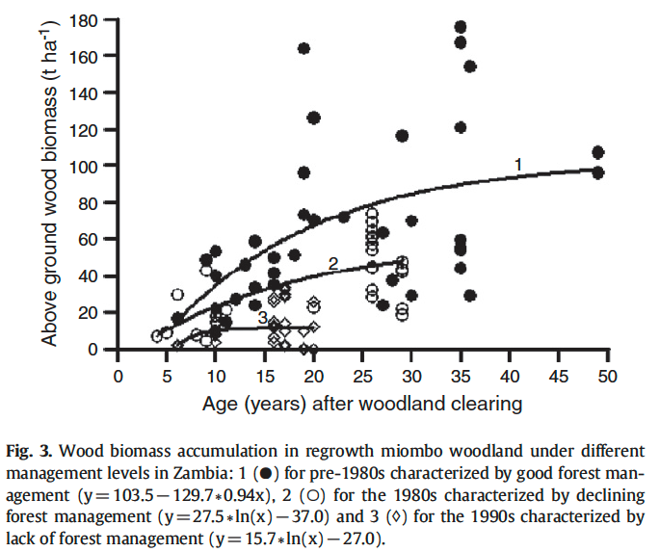
Uncertainty in Tool30
From IPCC’s “2019 Refinement to the 2006 IPCC Guidelines for National Greenhouse Gas Inventories”
2. IPCC AGB growth rates
(re)growth rates are not constant
Very variable
Higher in young and recently disturbed stands
Uncertainty is included, but Tool30 ignores it

Slide 12
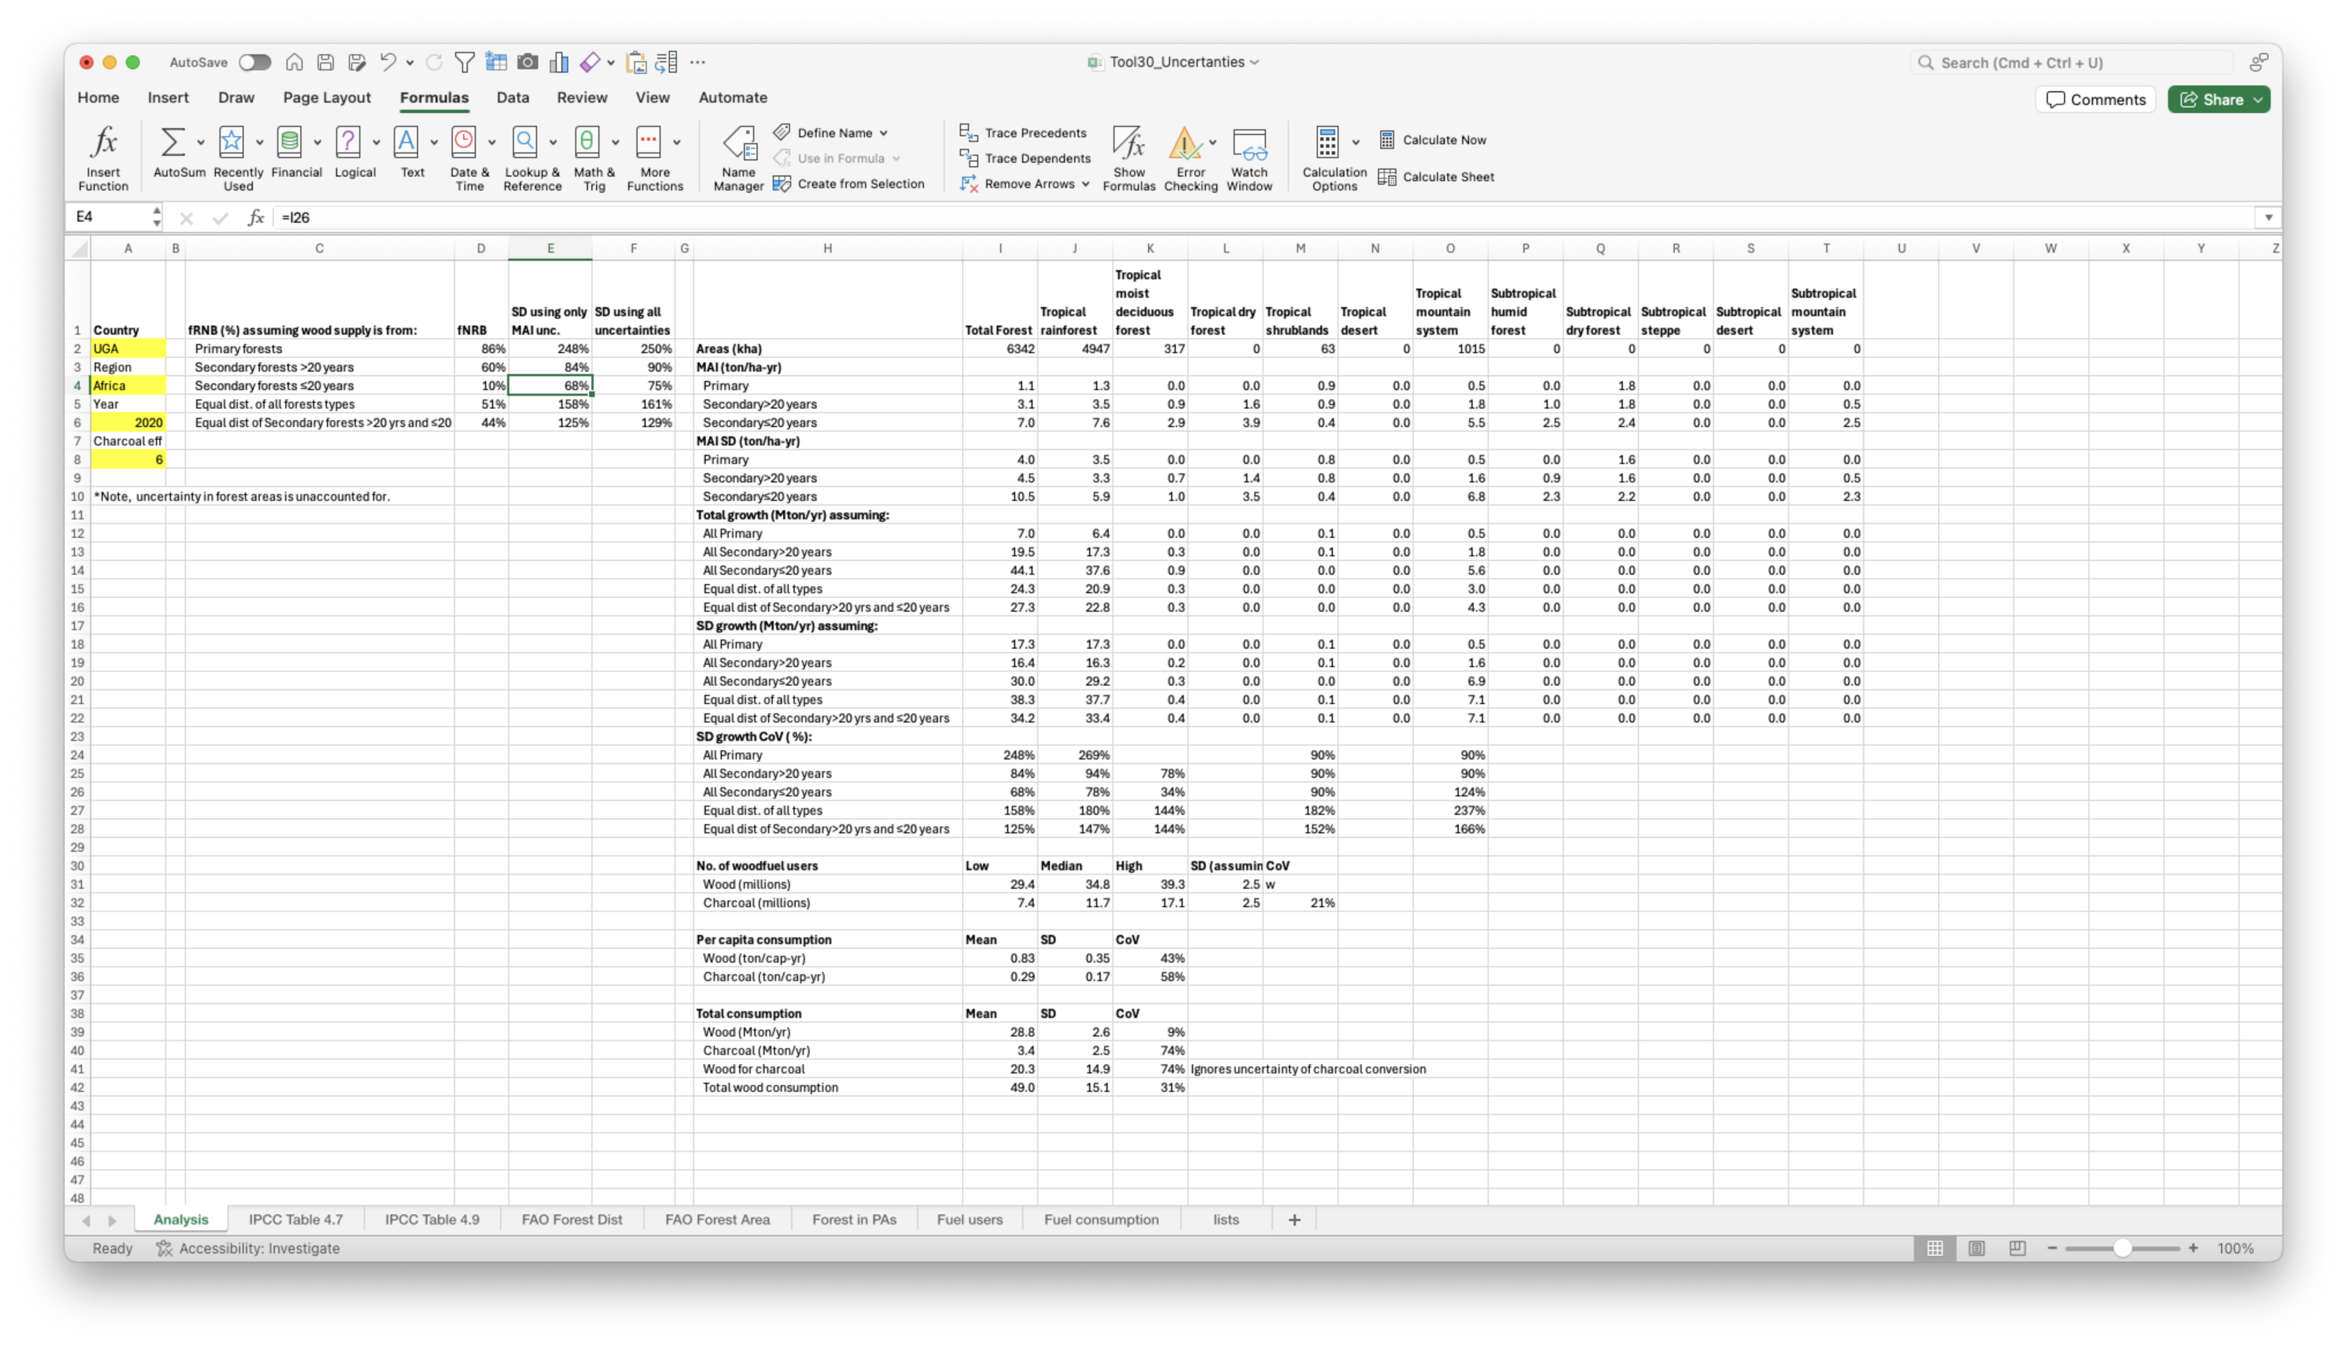
Uncertainty in Tool30 – how large is it?
We built a simple excel model using data recommended by Tool30 to calculate the uncertainty in fNRB using Standard Deviations in MAI from the IPCC

Slide 13
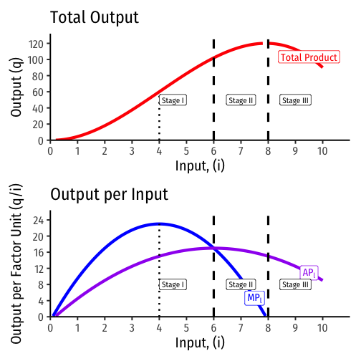
Marginal fNRB
What the heck are we talking about?
Common in Economics
The effect of a unit change in one variable on another variable
Utility, Cost/Revenue, Productivity
Output is a non-linear function of inputs like capital and labor (top graph)
An additional unit of input affects output differently depending on the quantity of inputs already being utilized (lower graph - blue line)
https://thoughtf20.classes.ryansafner.com/slides/3.2-slides#26

Slide 14
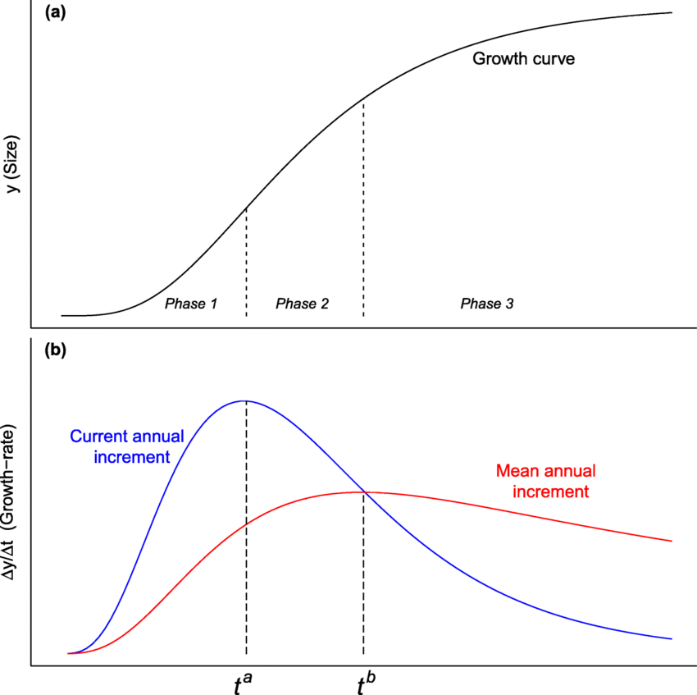
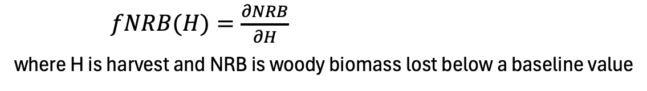
Marginal fNRB
How does this apply to trees?
“Output” is woody biomass
MP_{i} is Current Annual Increment (CAI)
Inputs are sunlight, nutrients, and the trees …
“leaves are the forest’s photosynthetic factory”
But its not a direct analogy
These plots show “time”, not inputs
We’re not directly interested the growth curve
We need to know how harvest leads to losses in stock
https://www.researchgate.net/publication/357163700_Growth_Equations_in_Forest_Research_Mathematical_Basis_and_Model_Similarities/figures?lo=1

Slide 15
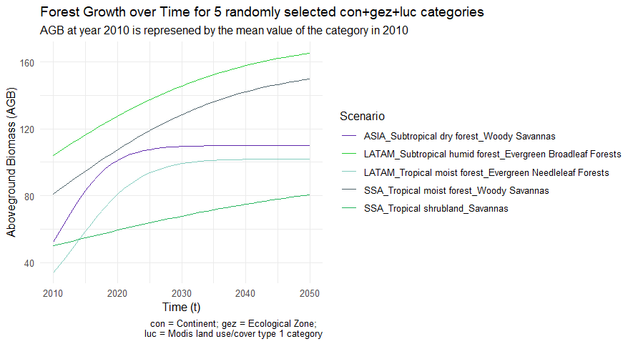
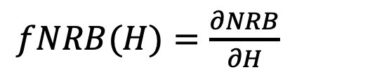
Marginal fNRB
Examples of growth functions used in different eco-regions
Things get more complicated
Each country we assess has dozens of growth functions distributed across thousands to millions of pixels
Harvest is very heterogenous
We’re using MoFuSS to “construct” a marginal fRNB function for each country:

Slide 16
Marginal fNRB
VERY preliminary results using Tanzania as a test case
We ran 10 simulations changing demand uniformly by ± 5, ± 10, ± 15, ± 25, & ± 50%
NRB as a function of wood harvest
fNRB and mfNRB as a function of wood harvest
mfNRB comes out 5-7% higher than fNRB

Slide 17
Marginal fNRB – next steps
Repeat in additional countries using uniform changes in demand
TZA is high fNRB, we’ll add a few others (e.g. MWI, SEN)
Low fNRB countries
Rapidly changing fuel mix (e.g. India, Kenya)
Examine the impact of non-uniform changes
Only fuelwood (mainly subsistence)
Only charcoal (fully commercial)
Specific admin units

Slide 18
Four ongoing developments
Moving beyond fNRB and AMS.II.G w/ Amazon Research
Prospective land use / cover simulations: Beyond simulating forests loss and gains w/ Vrije Universiteit Amsterdam
Charcoal kiln detection at scale, calibrating and validating woodfuel supply chains w/World Bank (pending)
FAO-funded assessment of miombo biome covering 8 Southern African countries: Angola, Botswana, Malawi, Mozambique, Namibia, Tanzania, and Zimbabwe plus a “deep dive” in Zambia

Slide 19
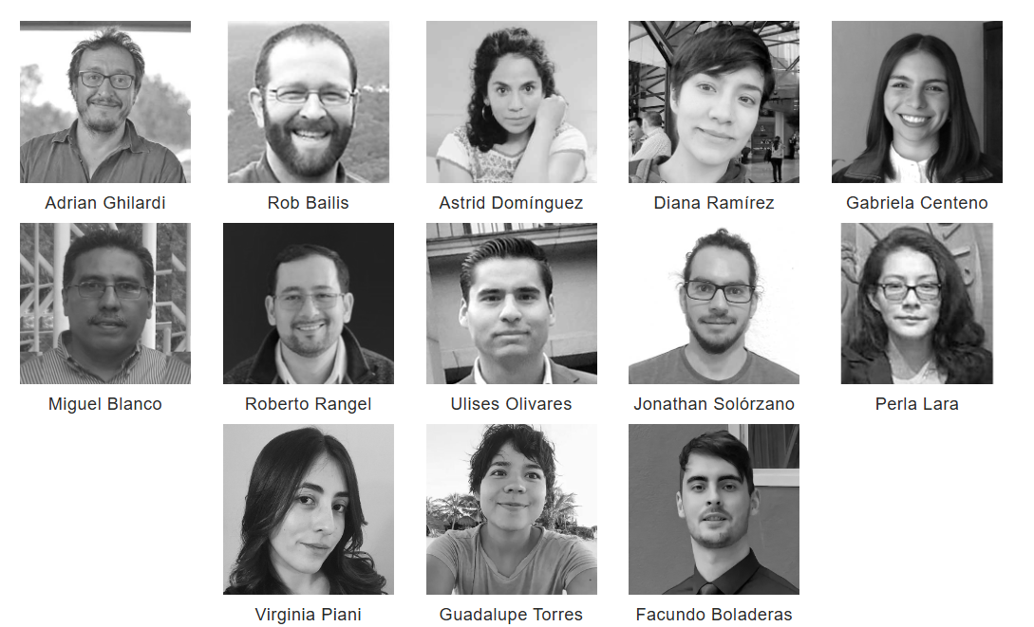


Thank you!
Team MoFuSS
Past and present funders

Slide 20
Uncertainty in Tool30
1. FAO’s 2000 Global Forest Resource Assessment
Why, in 2022, was the UNFCCC still recommending FAO data from 2000?
More recent GFRA’s don’t include data in the same form
What’s the problem?
Focused only on forest areas - not where most people harvest wood
An extreme example from Rwanda:
GFRA only includes montane forest covering 12% of the country
75% of Rwandans who collect fuelwood obtain it from private land and 88% travel less than 2km (MININFRA, 2020)

Slide 21
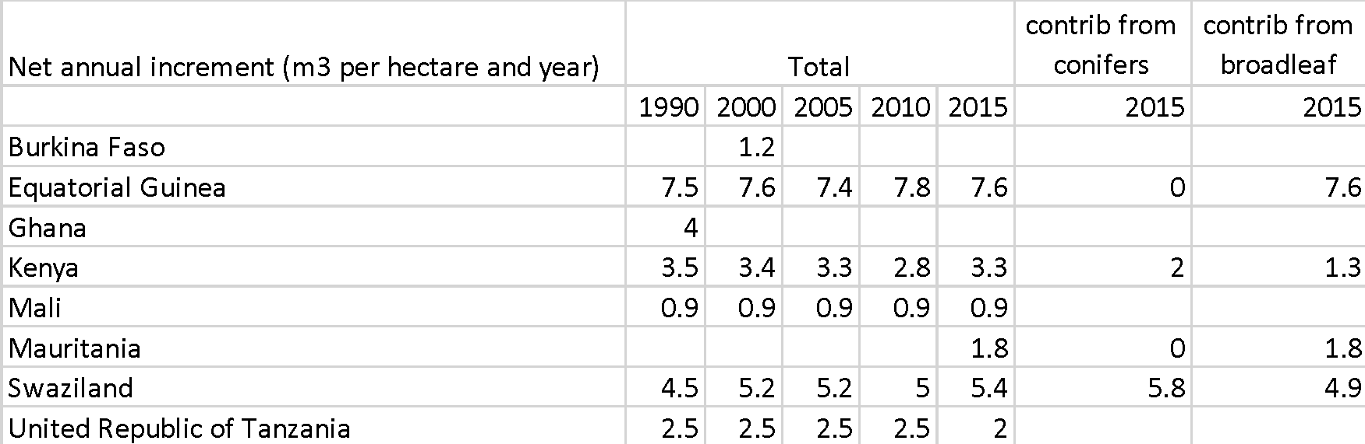
Challenges using Tool30 – misleading or ambiguous data sources
Other sources have very limited coverage. E.g. FAO’s 2015 GFRA:
Only includes 11 countries in SSA
Has no breakdown by forest type
Only conifer / broadleaf
Inconsistent presentation of data
No scientific sources cited
No uncertainty provided
From FAO’s “2015 Global Forest Resource Assessment”
Take Kenya as an example:
1.3 m³/ha-yr for broadleaf forests
< Mauritania ?!?!
0.9 dry-tons/ha-yr
lower than most IPCC data

